Slide 1
Server Side Programming

Slide 2
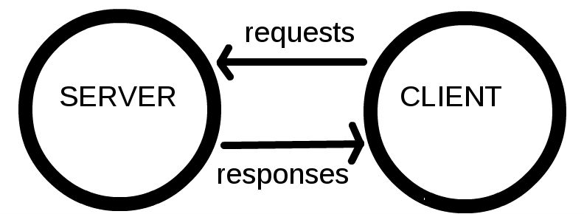
Clients and Servers
Computers connected to the web are called clients and servers.
A simplified diagram of how they interact might look like this:

Slide 3
Clients and Servers
Clients are the typical web user's internet connected devices and web-accessing software available on those devices (usually a web browser like Firefox or Chrome).

Slide 4
Clients and Servers
Servers are computers that store webpages, sites, or apps.
When a client device wants to access a webpage, a copy of the webpage is downloaded from the server onto the client machine to be displayed in the user's web browser.

Slide 5
Basic Terminologies
In addition to the client and the server, we must know about the following:
TCPIP
DNS
HTTP
Component Files

Slide 6
TCPIP
Transmission Control Protocol and Internet Protocol are communication protocols that define how data should travel across the web over internet.
This is like the transport mechanisms that let you place an order, go to the shop, and buy your goods. In our example, this is like a car or a bike (or however else you might get around).

Slide 7
DNS
Domain Name Servers are like an address book for websites. When you type a web address in your browser, the browser looks at the DNS to find the website's real address before it can retrieve the website.
The browser needs to find out which server the website lives on, so it can send HTTP messages to the right place.

Slide 8
HTTP
Hypertext Transfer Protocol is an application protocol that defines a language for clients and servers to speak to each other.

Slide 9
Component files
A website is made up of many different files, which are like the different parts of the goods you buy from the shop. These files come in two main types:
Code files: Websites are built primarily from HTML, CSS, and JavaScript, though you'll meet other technologies a bit later.
Assets: This is a collective name for all the other stuff that makes up a website, such as images, music, video, Word documents, and PDFs.

Slide 10
Server Side Scripting
Scripting or Programming that runs on a webserver.
Processing a form
Managing online purchases
Registering a new user
Booking a hotel room

Slide 11
A server-side dynamic web page
Is a web page whose construction is controlled by an application server processing server-side scripts.
In server-side scripting, parameters determine how the assembly of every new web page proceeds, including the setting up of more client-side processing.

Slide 12
A client-side dynamic web page
It processes the web page using HTML scripting running in the browser as it loads.
JavaScript and other scripting languages determine the way the HTML is parsed into the Document Object Model that represents the loaded web page.
The same client-side techniques can then dynamically update or change the DOM in the same way.

Slide 13
Web Server
Web server refers to server software, or hardware dedicated to running said software, that can serve contents to the World Wide Web.
A web server processes incoming network requests over HTTP and several other related protocols
The primary function of a web server is to store, process and deliver web pages to clients.
The communication between client and server takes place using the Hypertext Transfer Protocol (HTTP).

Slide 14
What is a communication protocol?
Combination of three things:
Syntax (data format and coding)
Semantics (control information and error handling)
Timing (speed matching and sequencing)

Slide 15
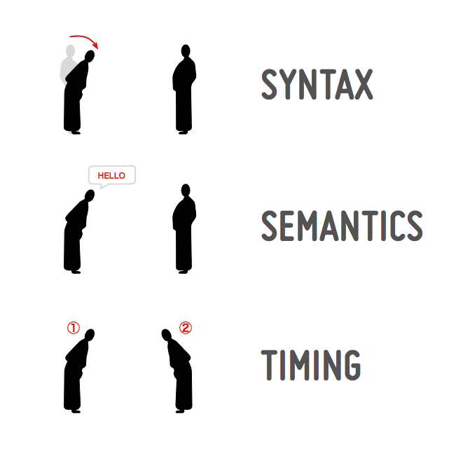
What is a communication protocol?

Slide 16
What is a communication protocol?
An online communication protocol contains the same elements.
The syntax will be the sequence of characters such as keywords we use for writing the protocols.
The semantics is the meaning associated with each of these keywords
The timing is the order in which two or more entities exchange these keywords.

Slide 17
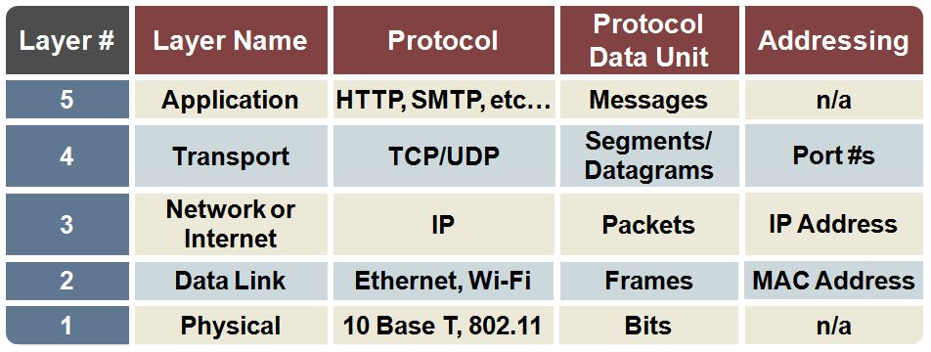
TCP/IP Layers

Slide 18
So what happens, exactly?
When you type a web address into your browser:
The browser goes to the DNS server, and finds the real address of the server that the website lives on.
The browser sends an HTTP request message to the server, asking it to send a copy of the website to the client.

Slide 19
So what happens, exactly?
If the server approves the client's request, the server sends the client a "200 OK" message, which means "Of course you can look at that website! Here it is", and then starts sending the website's files to the browser as a series of small chunks called data packets.
The browser assembles the small chunks into a complete website and displays it to you.

Slide 20
Telnet Example
TELNET www.bahria.edu.pk 80
In telnet type the following and press ENTER twice
GET / HTTP/1.1
HOST: www.bahria.edu.pk
HTTP: Response Codes

